Slide 1

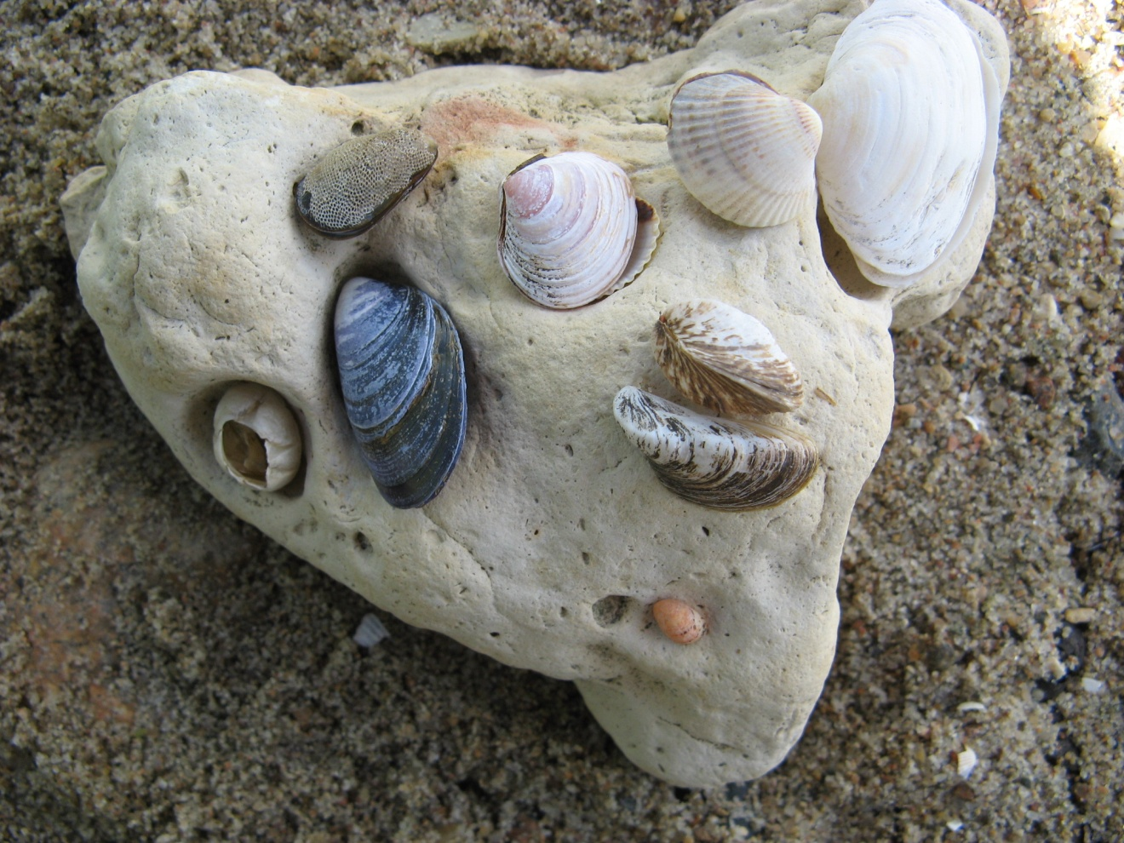
Läänemere olulisemad karbid
Important shells in Baltic see
The study materials have been prepared within the project "ESTIC - Sustainable School Policy" which has been funded with support from the EEA and Norway grants
Ivi Rammul
Foto: Ivi Rammul

Slide 2
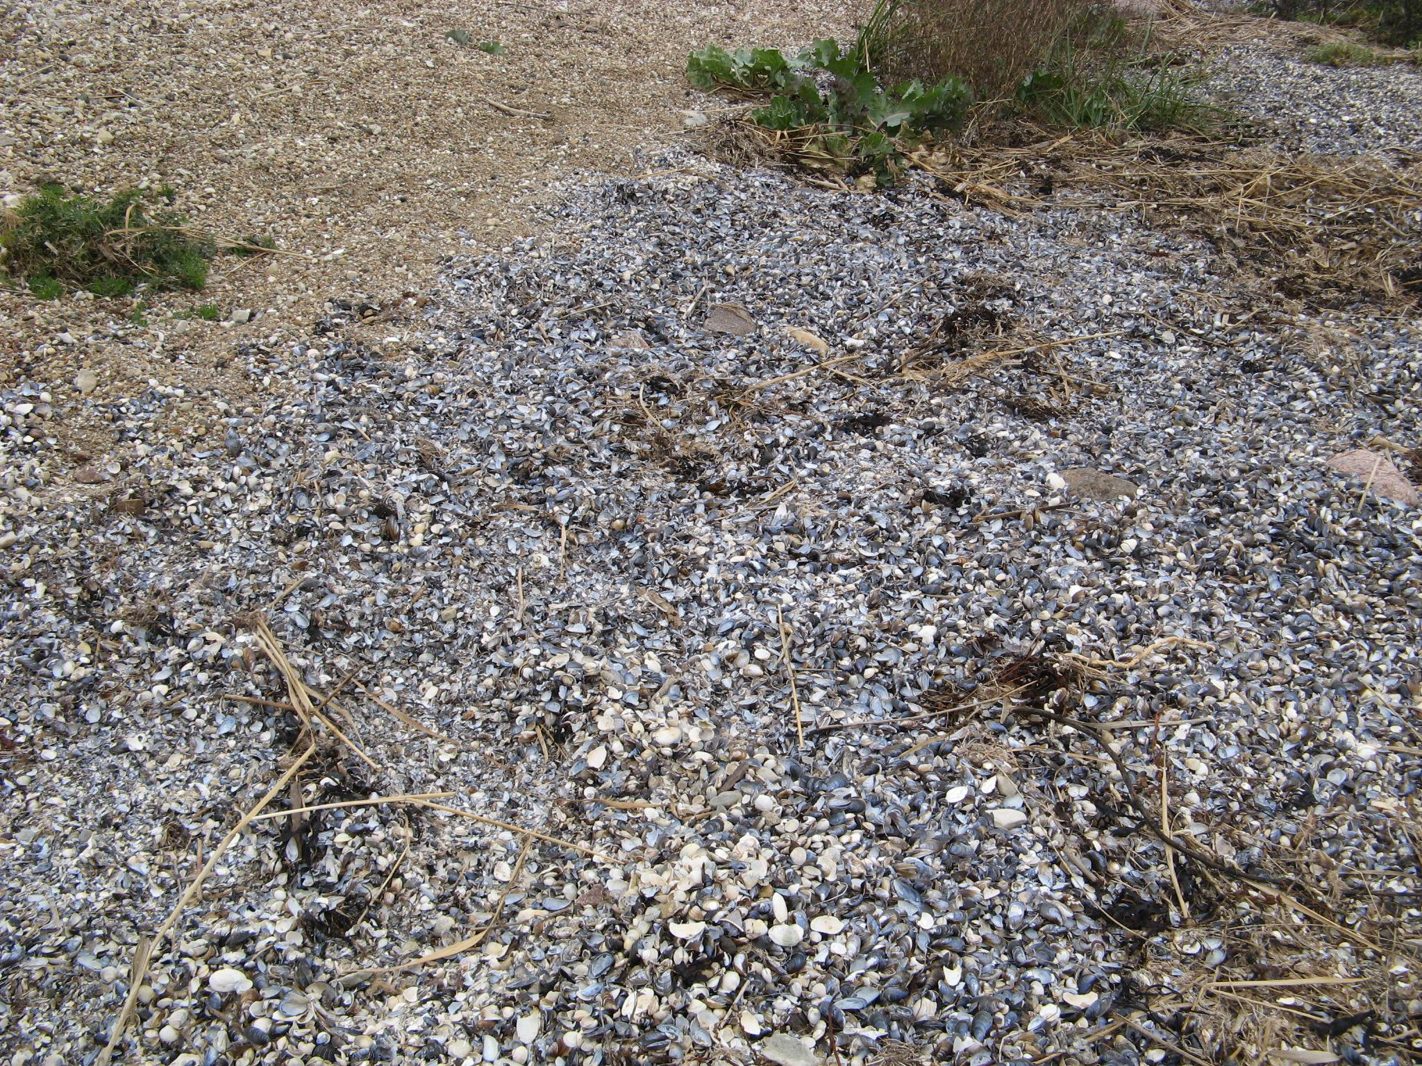
TÜHJAD KOJAD RANNAL
EMPTY SHELLS IN SEASHORE

Slide 3
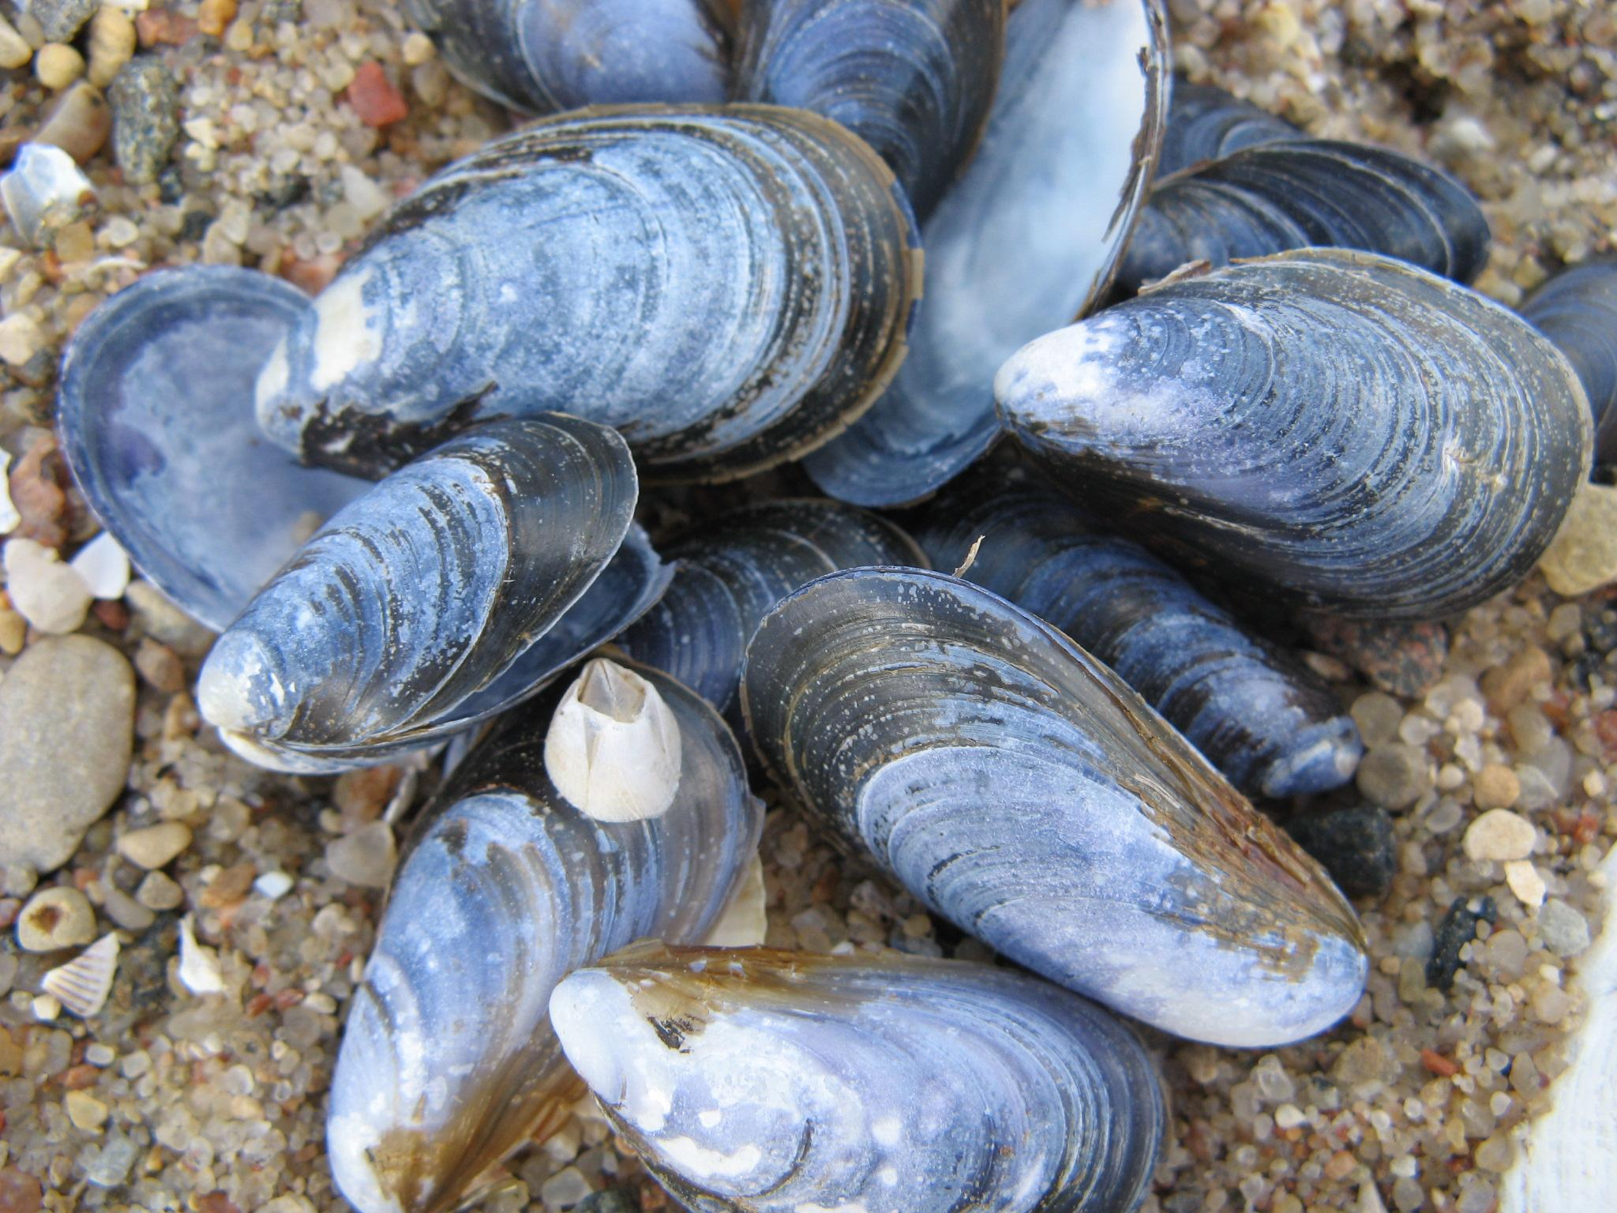
Söödav rannakarp
Mytilus edulis

Slide 4
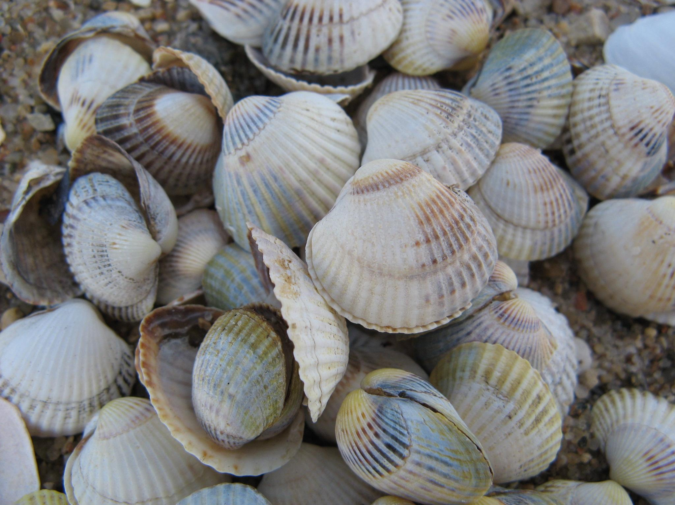
Südakarp
Cardium edule

Slide 5
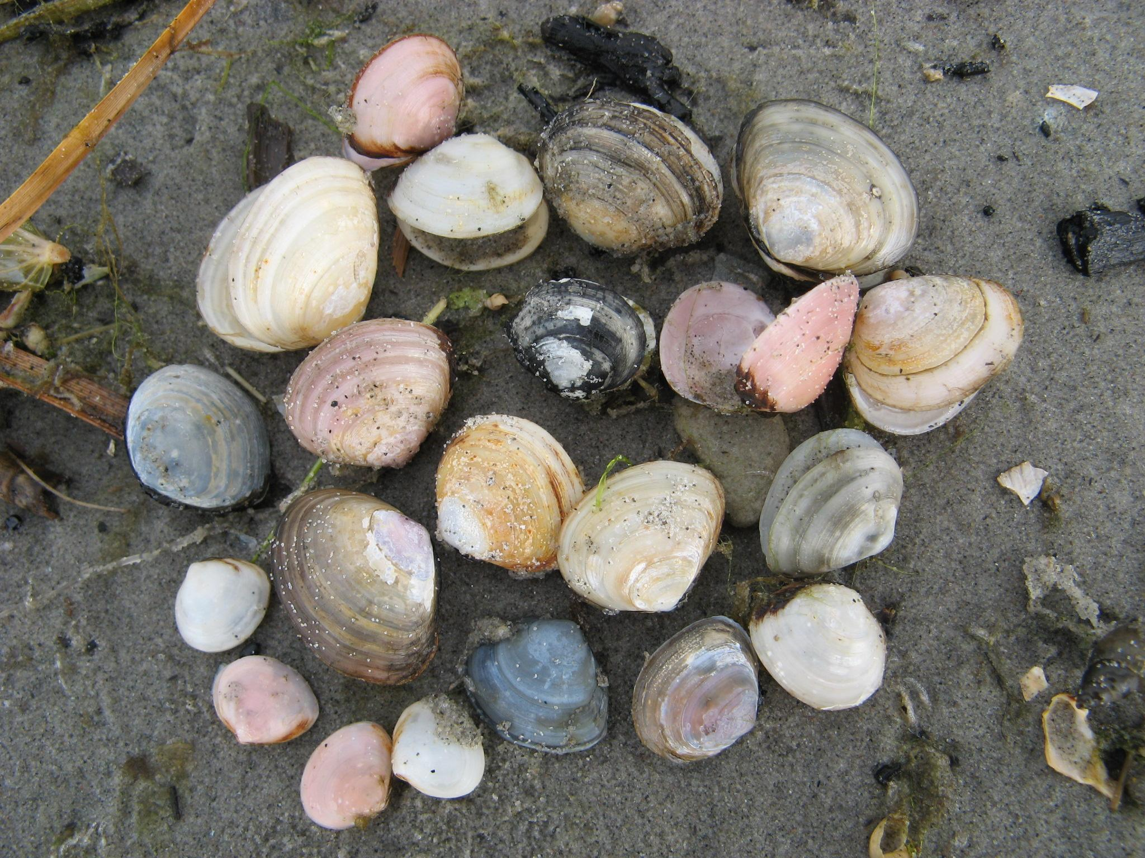
Balti lamekarp
Macoma baltica

Slide 6
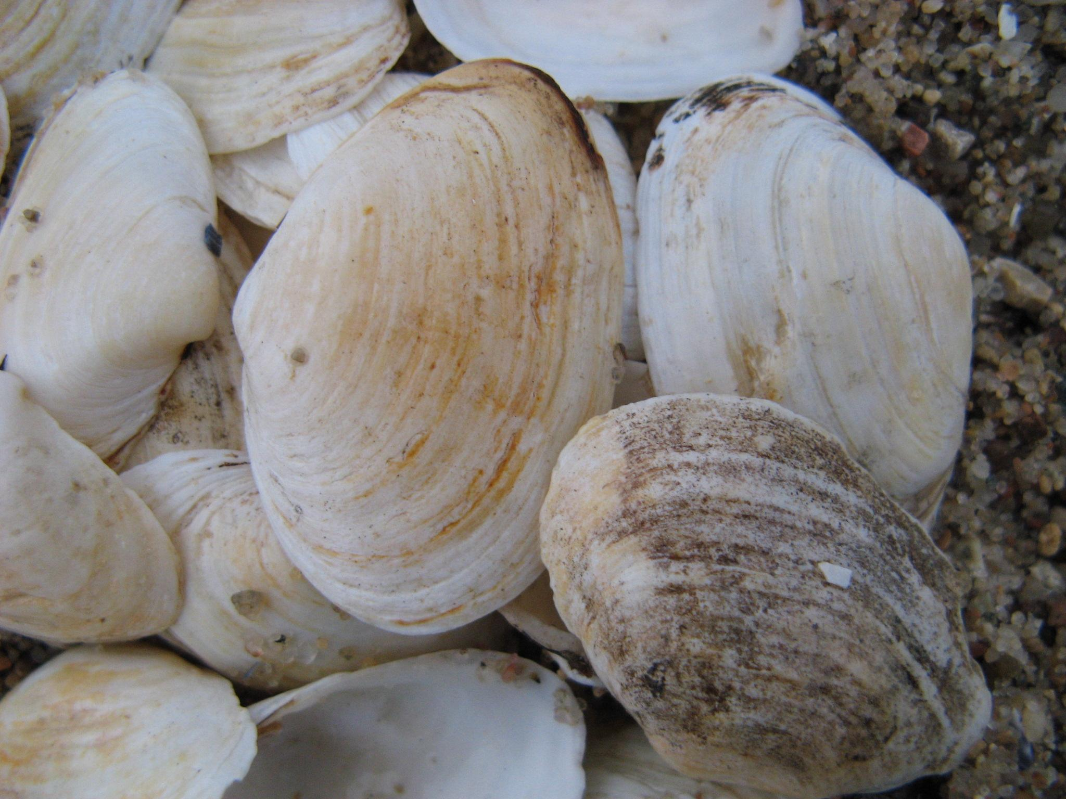
Liiva uurikkarp
Mya arenaria

Slide 7
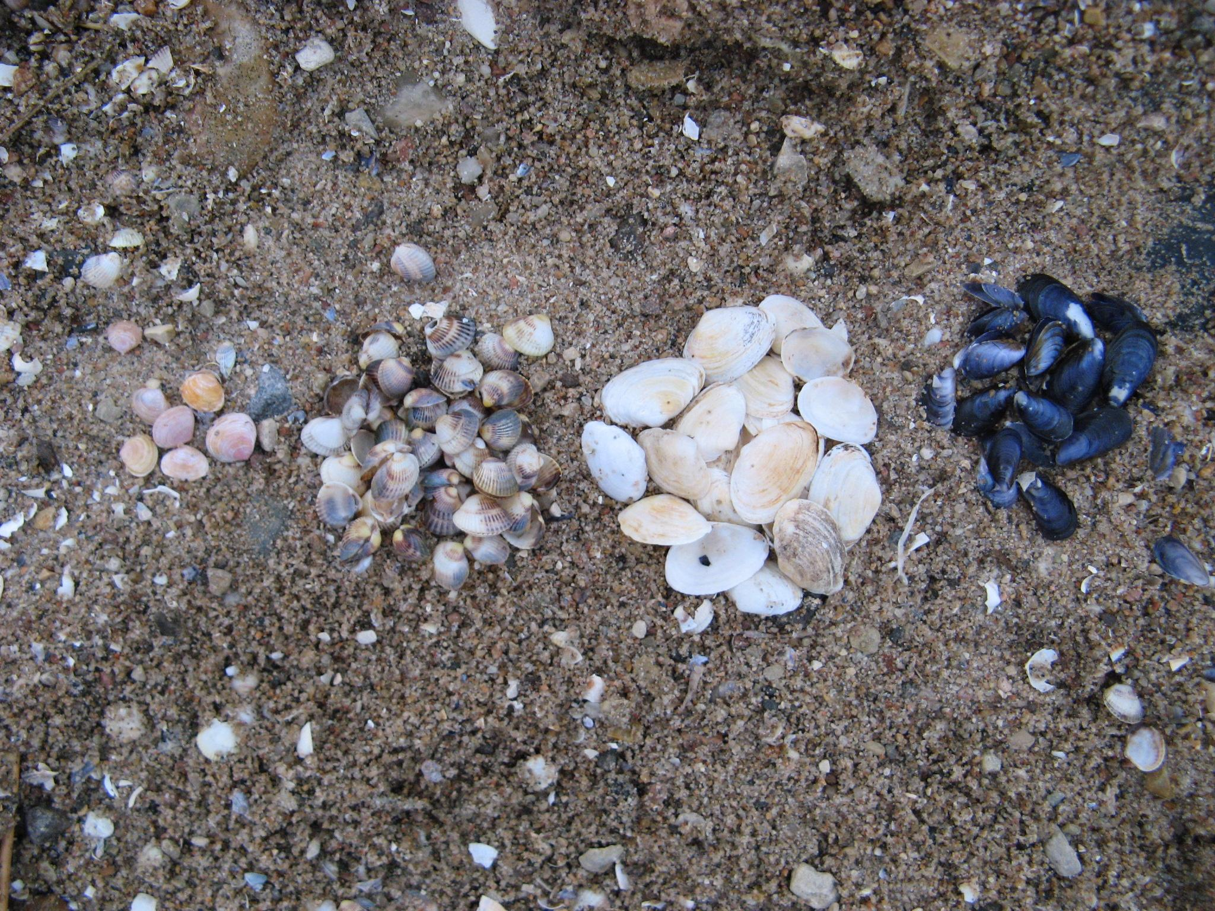

Slide 8
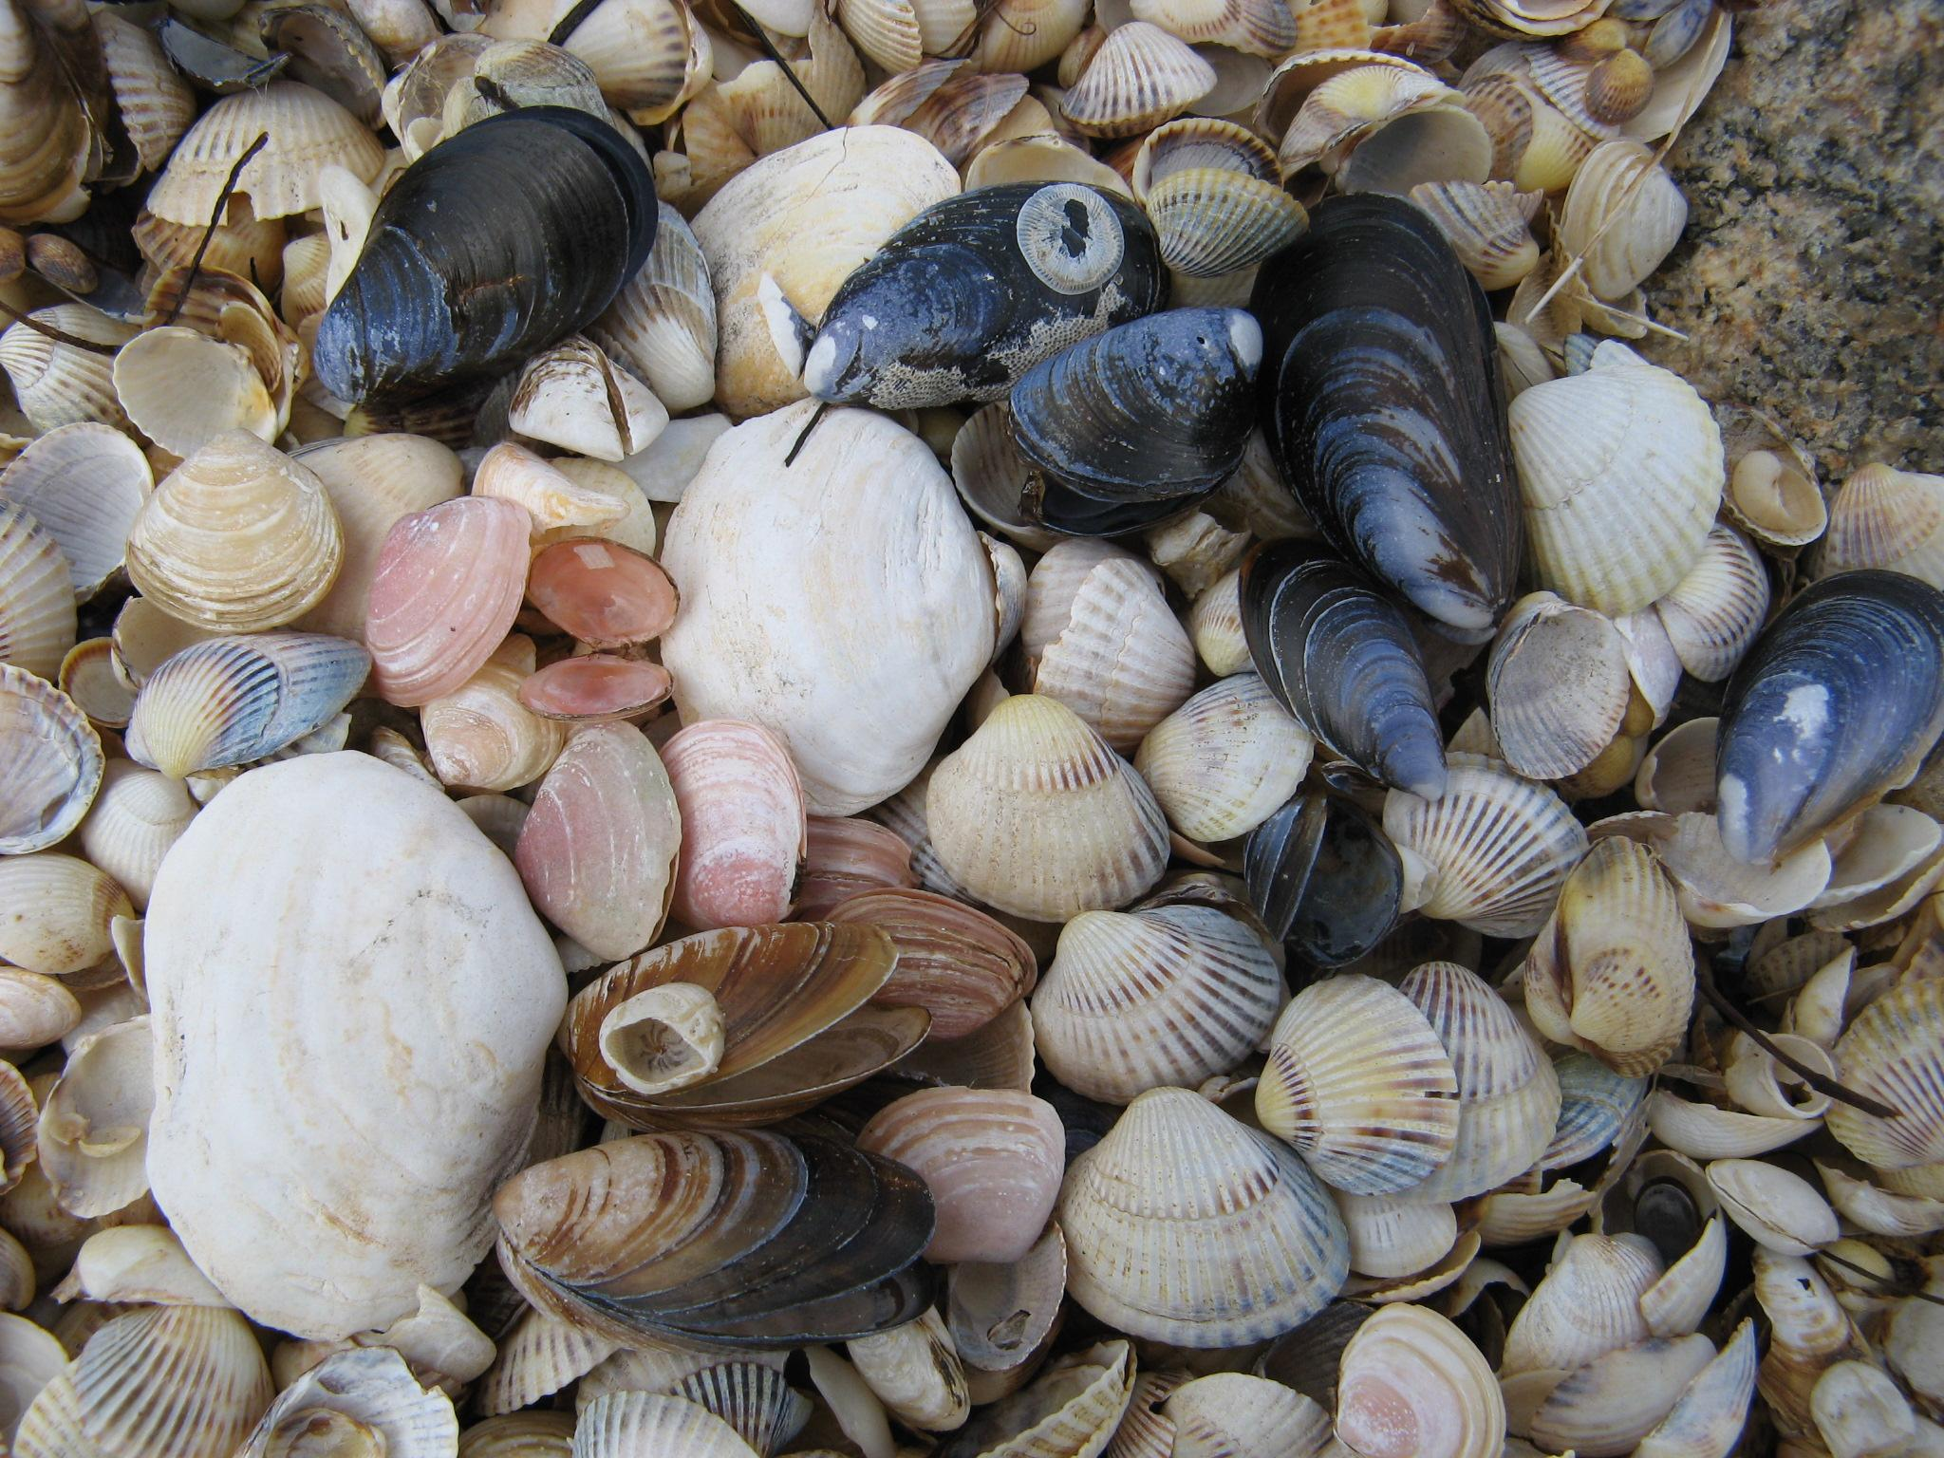

Slide 9
Mereranda on lained toonud erinevaid karpide kodasid. Kõik on tühjad kojad. Arutle pinginaabriga või rühmas või kogu klassiga järgmiste küsimuste üle:
Mis on karpide kodade erinevate värvuste võimalikud põhjused?
Miks on rannas massiliselt karpide kodasid?
Miks on mõnes rannas vähe kodasid ja mõnes rohkem?
Leia võimalikult palju erinevaid põhjuseid miks karpide kojad on tühjad , ilma loomadeta.
Läänmere karbid on mõõtmetelt väiksed ja kojad on küllalt haprad võrreldes soolaste merede karpidega. Leia sellele seletus. Vajadusel kasuta interneti abi.

Slide 10
Waves have brought different seashells to the seashore. All of them are empty. Discuss the following questions with your deskmate, in a group or with the whole class:
What are the possible reasons for the different colors of the seashells?
Why are there so many seashells on the seashore?
Why are there more seashells on some beaches and fewer on others?
Think of as many possible reasons as you can as to why the shells are empty, without occupants.
The seashells of the Baltic Sea are smaller and more fragile, compared to the seashells of salty seas. Find an explanation on the Internet.

